Slide 1
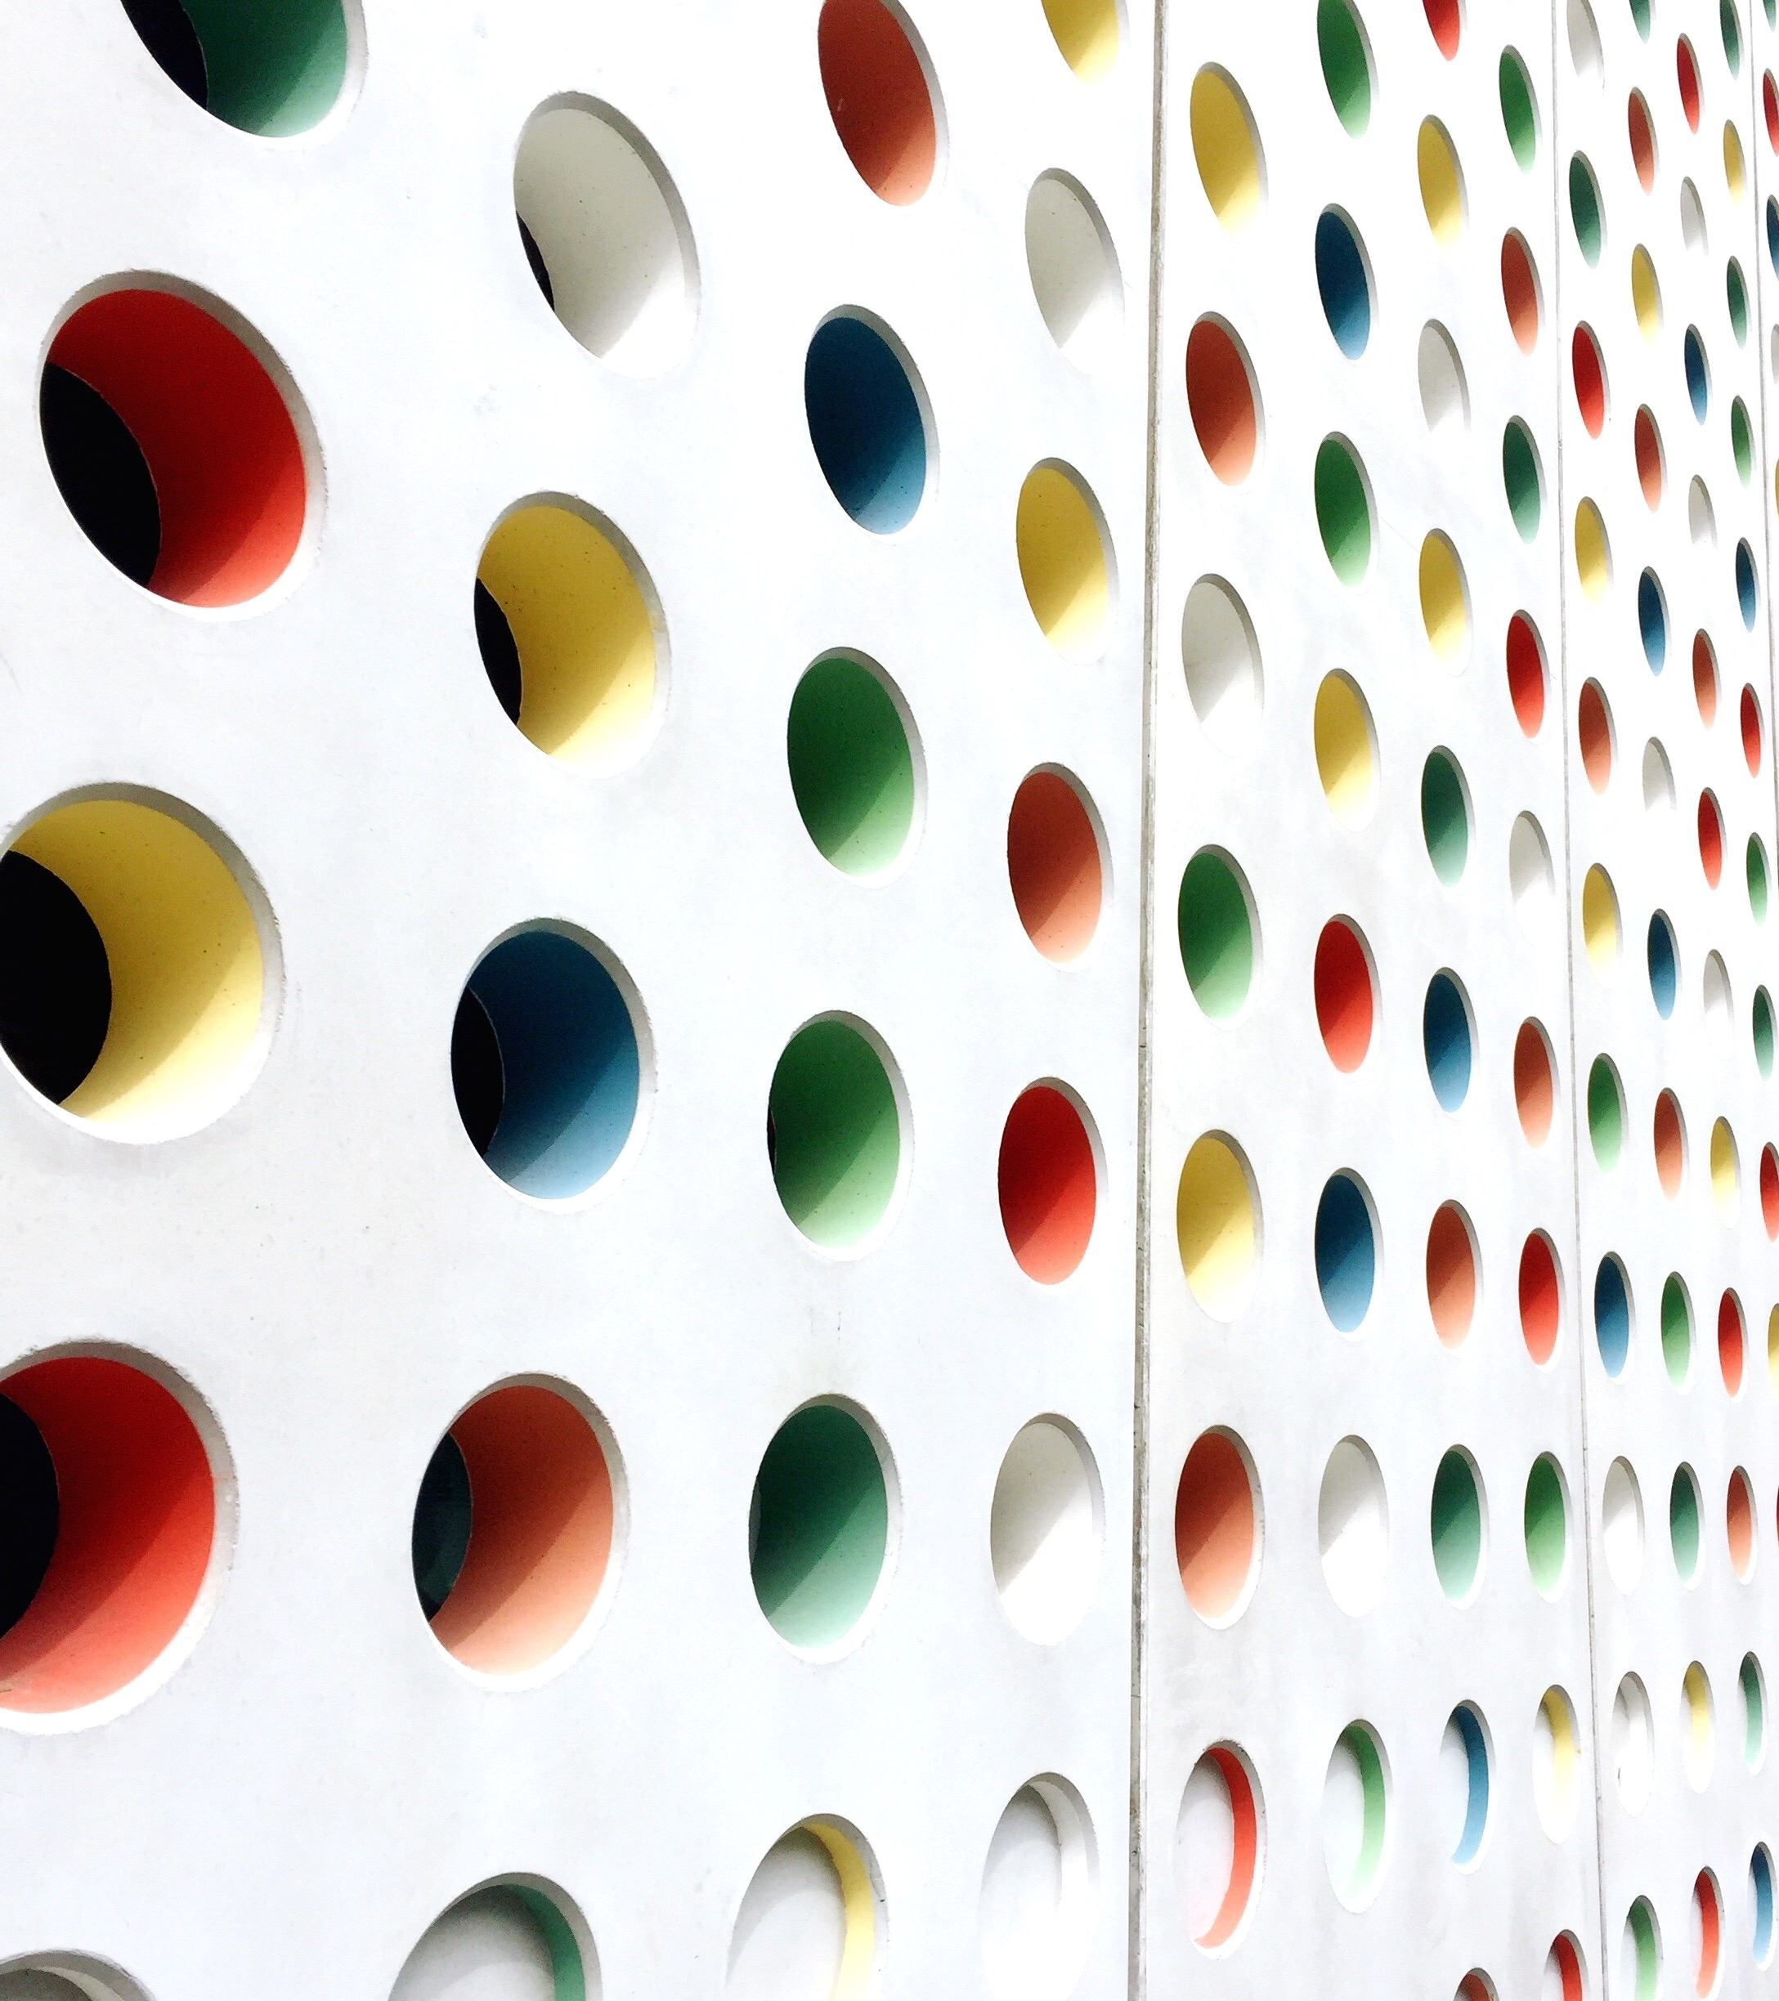
A new court in town
Guillermo Garcia-ESCRIBANO

Slide 2
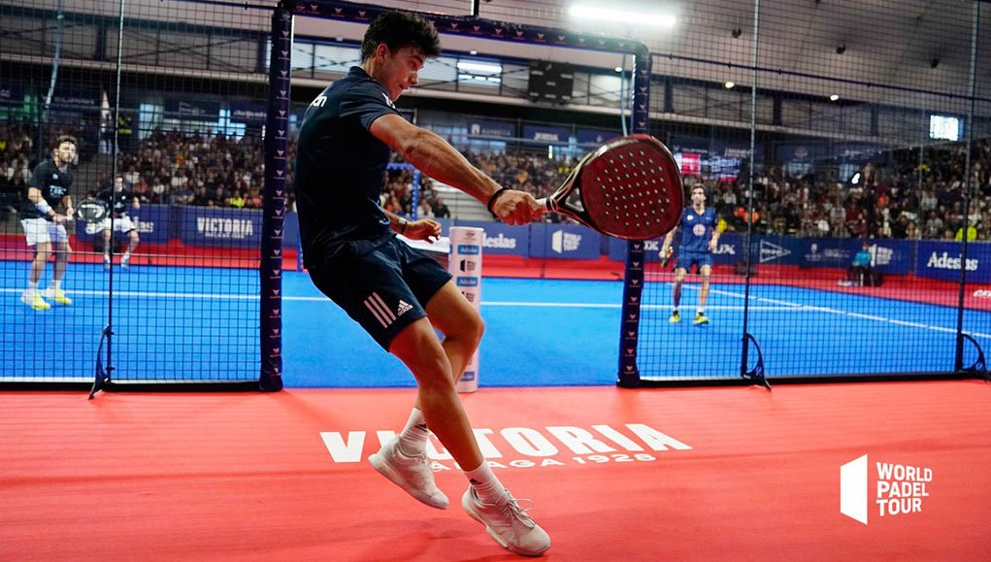
Business problem
An investment fund is planning to build a padel court in Munich, Germany, after noticing growing interest in this sport.
They want to pick a cheap location with attractive venues in the proximity while avoiding competitors in the same area.
The manager ignore which neighborhoods in Munich would be most fitting for the new padel court. They decide to use data science to reduce the pool of candidates to just a handful.

Slide 3
Data acquisition and cleaning
An online public list in CSV with the names of the different neighborhoods (available at the city’s open data portal www.opengov-muenchen.de).
Centers of candidate neighborhoods and approximate addresses of centers of those areas generated using GeoPy's Nominatim reverse geocoding.
Number of public venues and their type and location in every neighborhood obtained using Foursquare API.
Duplicate and error-causing data were dropped. Unnecessary features were eliminated.
A total of 2925 venues for 106 neighborhoods, with 279 unique venue categories.

Slide 4
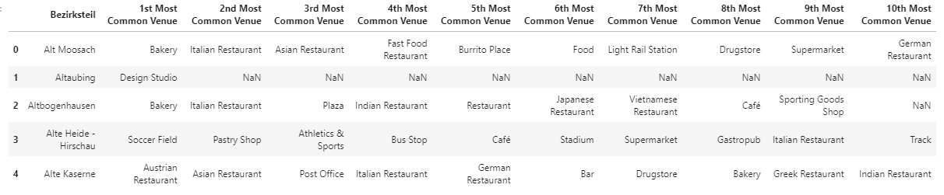
Ranking of most common venues
Venue categories were one hot encoded. Their frequency was calculated.
A ranking helps to visualize the different types of venues.

Slide 5
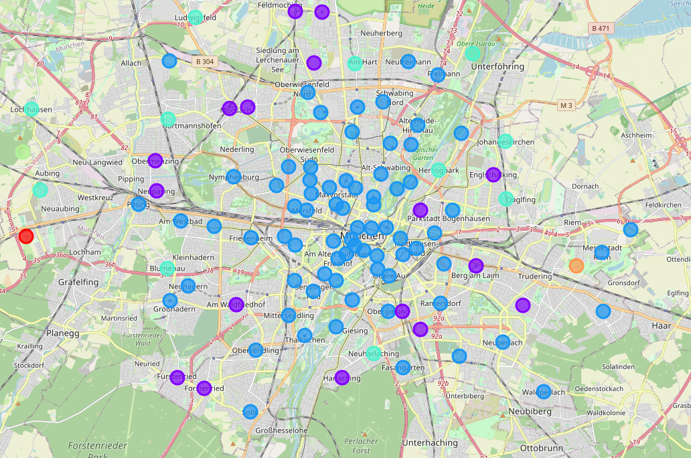
K-means clustering I: Downtown areas
Downtown neighborhoods are too expensive for a padel court. Fortunately, they usually present a high frequency of cafés and restaurants so it is easy to detect them.
The map shows in dark blue the cluster of downtown-like neighborhoods that is directly discarded.

Slide 6
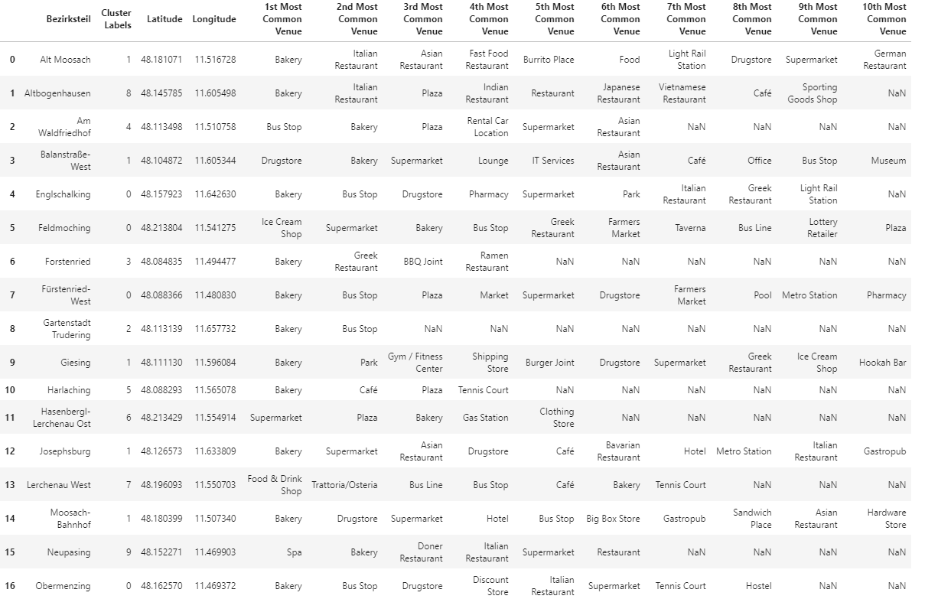
Tennis court cluster
Light blue cluster (17 areas) includes all 3 neighborhoods with tennis courts: they will be our reference. They mostly have bus stops and bakeries in common.

Slide 7
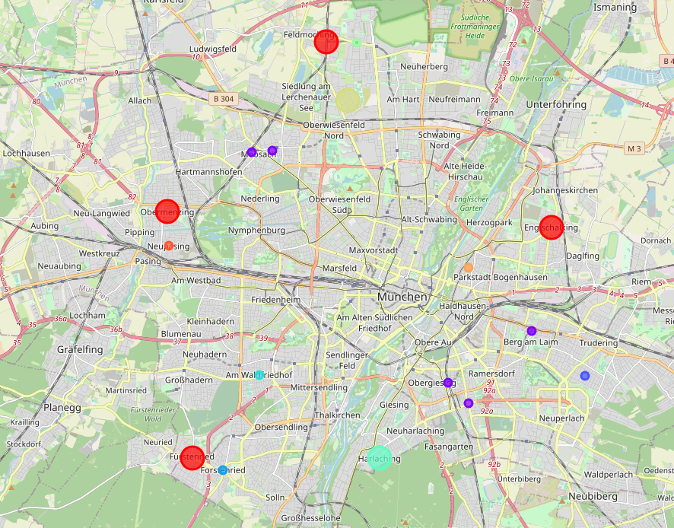
K-means clustering II: Reducing candidates
Evaluating 14 candidate neighborhoods would consume too many resources. Another clustering process shows that 3 of them (new cluster in red) are particularly similar to Obermenzig’s, the tennis court neighborhood with most venues - mostly transport, bakeries and markets. This makes these 3 neighborhoods especially attractive for potential users.

Slide 8
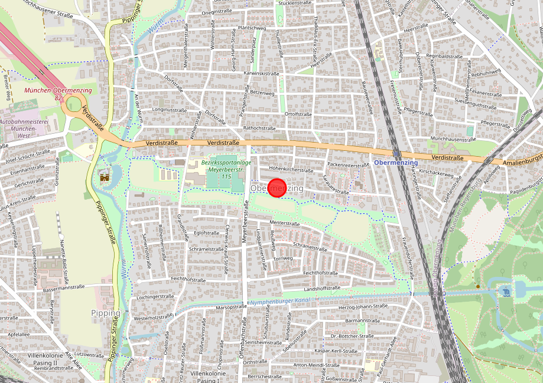
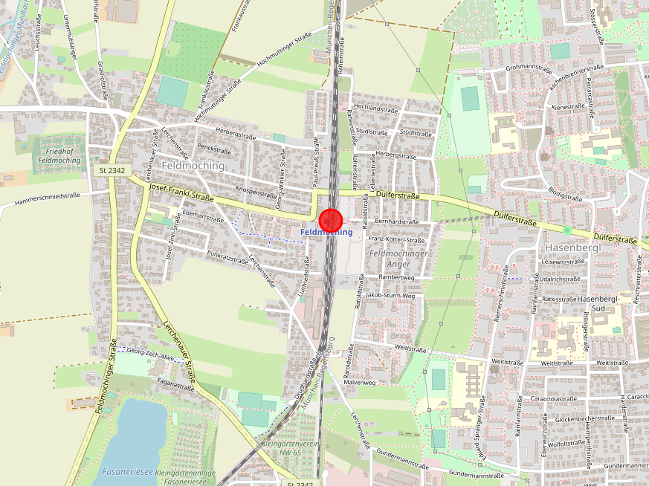
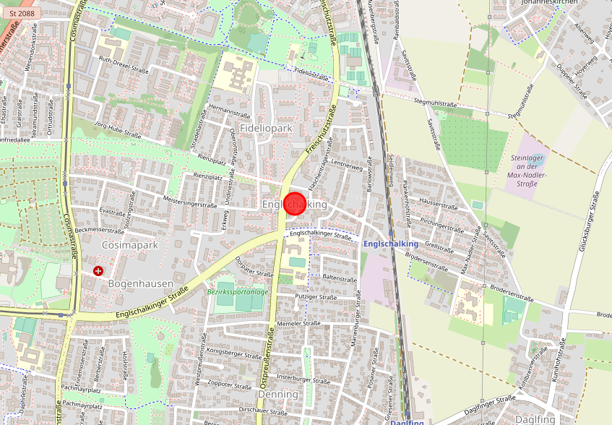
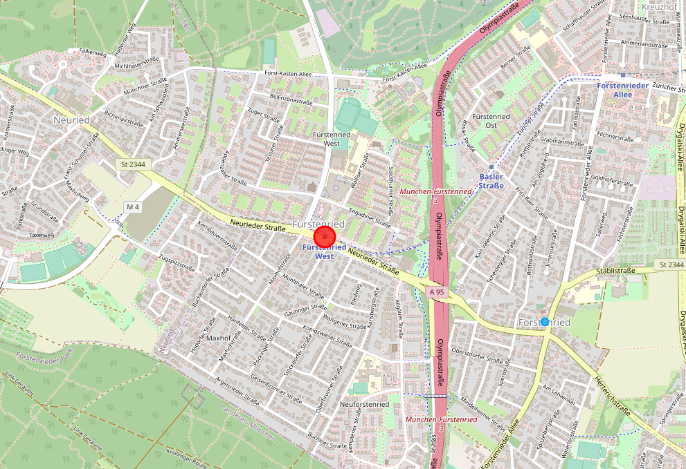
K-means clustering II: Reducing candidates
A closer inspection reveals that the cluster is also geographically very similar: neighborhoods in the outskirts of Munich with good transport connections and free space in the proximity available for the construction of padel courts. Powerful candidates.
Obermenzig
Feldmoching
Englschalking
Fürstenried

Slide 9
Conclusions
Clustering algorithm has revealed 3 potential candidate neighborhoods which are very similar to one other neighborhood where a tennis court is already successful. Being the two sports alike, we could expect our padel court to perform well in any of the 3 candidate areas.
Tennis courts in Munich seem to be frequently close to particular venues such as bus stops and bakeries. This venues could make the location more attractive for users, who could also be public transport users and may want to eat a snack or do small groceries before or after playing.
Final decision must be made after considering other factors such as real estate availability, prices, social and economic dynamics of every neighborhood or attractiveness of the area.

